Slide 1
机器人与人工智能实验室 Robotics and Artificial Intelligence Laboratory
WELCOME TO

Slide 2
MPU6050 Data Accessing
1. Introduction
The model of IMU unit for cat is MPU6050. The accelerometer is mainly used to measure the acceleration of movement, while the gyroscope mainly measures the angular velocity of rotation.
The MPU6050 IMU integrates a 3-axis accelerometer and a 3-axis gyroscope on a single chip. Therefore, we can measure the output of three accelerometers and gyroscopes.

Slide 3
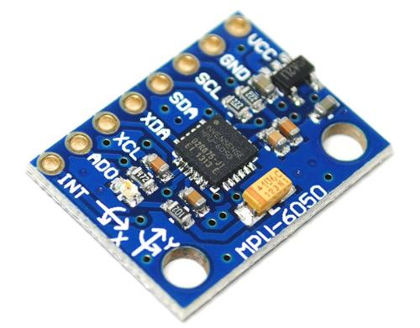
MPU6050 Data Accessing
The module is a kind of sensor based on MEMS (micro electro mechanical system) technology. It embeds accelerometer and gyroscope into a chip, which uses I2C communication protocol.

Slide 4
MPU6050 Data Accessing
MPU6050 uses ADC (digital to analogue signal converter) for gyroscope and accelerometer to convert the measured analogue value into the output digital value.
In order to accurately track the fast and slow motion, the measurement range of the sensor is controlled:
The measuring range of gyroscope is ± 250, ± 500, ± 1000, ± 2000 DEG / S (DPS), and that of accelerometer is ± 2, ± 4, ± 8, ± 16g.

Slide 5
MPU6050 Data Accessing
2. Unit Conversion
To convert the original 16 bit data to the unit of gravity acceleration g, the range of the sensor matters.
The default measurement range is ± 2g, with a total width of 4g. The maximum reading of 16 bit data is 65536. Divided by 4 is 16384, which is the value corresponding to 1g acceleration. Before printing, divide the data by 16384 to get the value in g.
The unit conversion of angular velocity is the same.

Slide 6
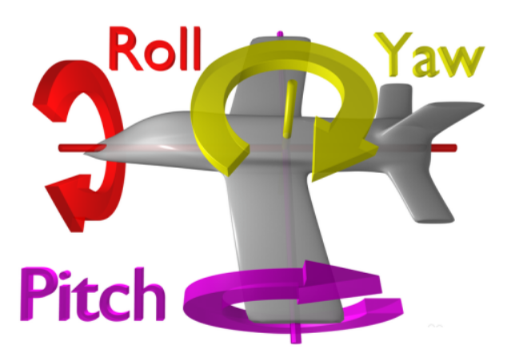
MPU6050 Data Accessing
3. Euler Angle
Identification of Yaw, Pitch and Roll:

Slide 7
MPU6050 Data Accessing
4. Principles of Accelerometer
The accelerometer adopts the piezoelectric effect.
Analogy: There is a ball in a cube box. The four walls of the box are made of piezoelectric crystal material. When the box tilts, because of gravity, the ball will move in the direction of tilt. When the ball touches the wall, it generates a piezoelectric current. (Figure Next Page)
There are three pairs of opposite walls in the box. Each pair of walls corresponds to an axis in 3D space: X axis, Y axis and Z axis. According to the current generated by the piezoelectric wall, we can determine the direction and size of the dip angle.

Slide 8
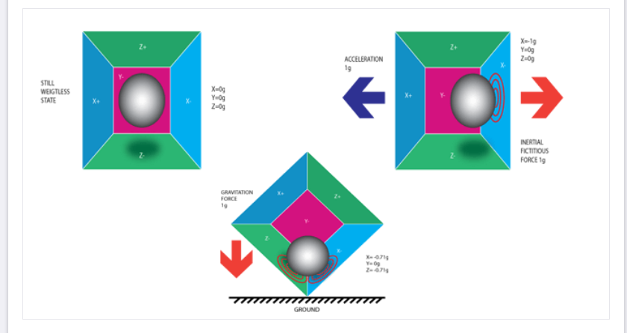
MPU6050 Data Accessing

Slide 9
MPU6050 Data Accessing
When the cat body tilts around the y-axis, the acceleration of gravity will produce two acceleration components on the x-axis and z-axis.
From the sensor, we can read the three axis acceleration at one time. Therefore, it is easy to calculate the cat's dip angle around the y-axis through the inverse trigonometric function. (Figure Next Page)

Slide 10
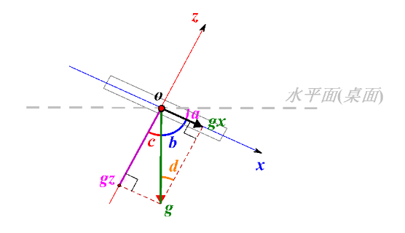

MPU6050 Data Accessing
Calculation:

Slide 11
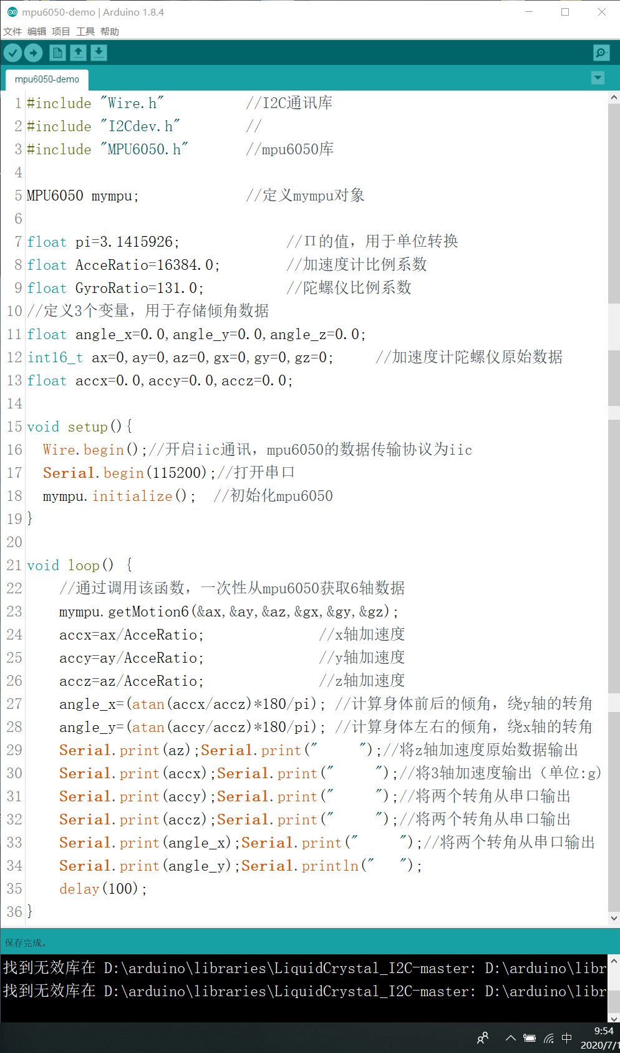
MPU6050 Data Accessing
5. Coding

Slide 12
MPU6050 Data Accessing
Next:

Slide 13
MPU6050 Data Accessing
The dip angle obtained in this way has error. When the cat moves, it has an acceleration and deceleration process, so it will produce an acceleration in addition to the gravity acceleration g.
At the same time, there are many errors when the sensor is manufactured. This requires calibration when we use it.
We need to carry out a variety of filtering algorithms to improve the accuracy of the data.

Slide 14
MPU6050 Data Accessing
6. Remarks
Because the data output from the serial monitor can only show the change of angle data, the intuition is not strong enough.
Through data visualization, we can dock the cat's dip angle with the 3D model in the processing software in real time, which makes it intuitive.

Slide 15
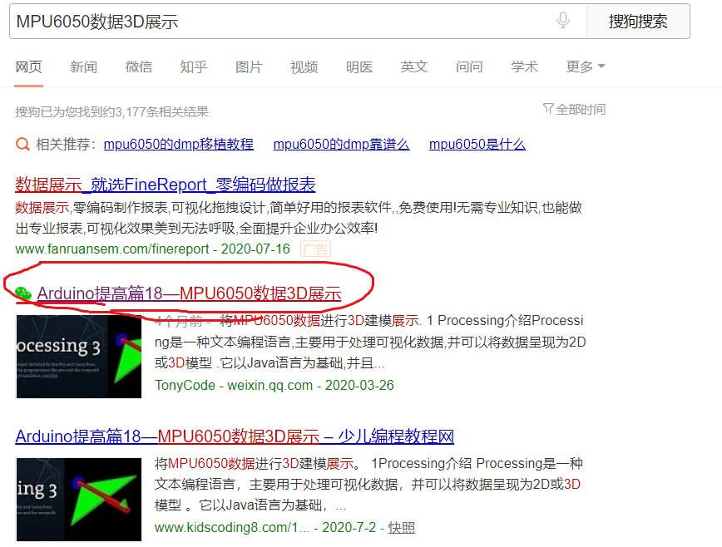
MPU6050 Data Accessing
7. Appendix
Specific settings can be made through the articles searched in the figure.

Slide 16

THANK YOU
林天麟 教授
香港中文大学（深圳）
机器人与人工智能实验室
WeChat: tinlunlam

